Slide 1
Introduction to Genealogy Session 2 Genealogical Resources
Welcome to…
Elizabeth Briggs

Slide 2
Topics To Consider
Well Known On Line Databases e.g.
https://familysearch.org/ Free
www.ancestry.ca $
www.findmypast.co.uk/ $
www.myheritage.com $
Library & Archives Canada
Home Children,
East European,
Métis,
Naturalization
Immigration………….
Archives Manitoba – Estate Records
Hudson’s Bay Company Archives
England, Wales, Scotland & Ireland
Maps
Illness in Earlier Times

Slide 3
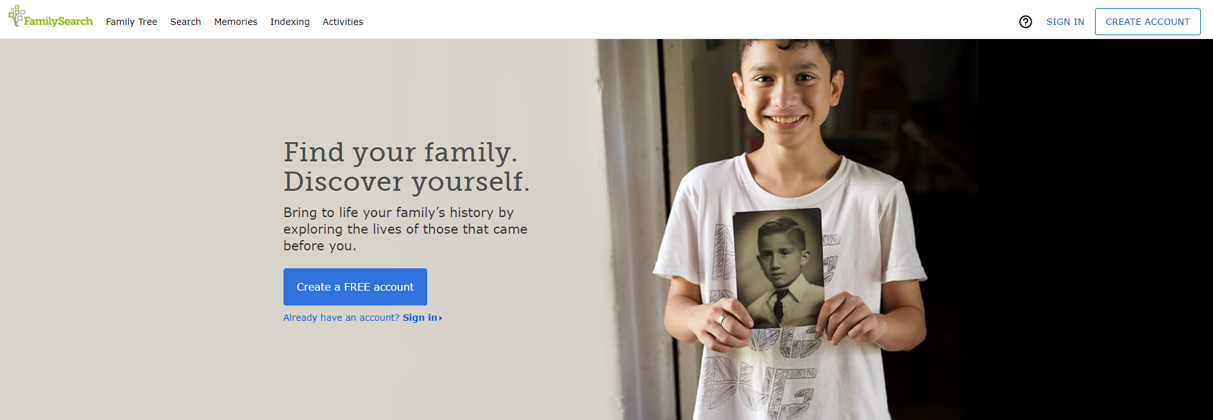
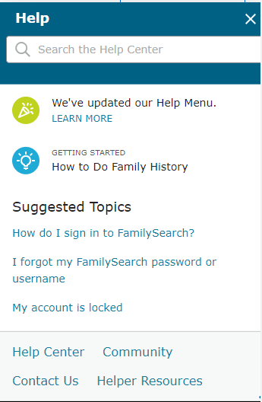
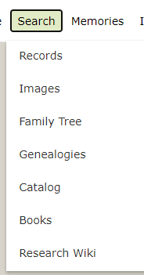
Explore this Site - Free https://familysearch.org/

Slide 4
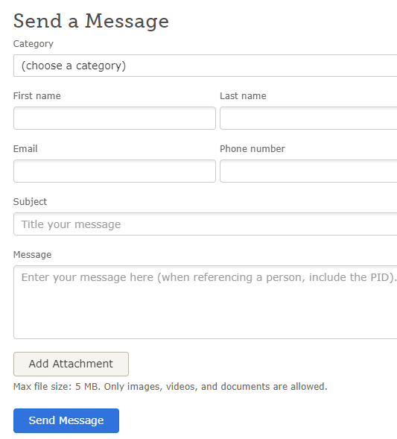
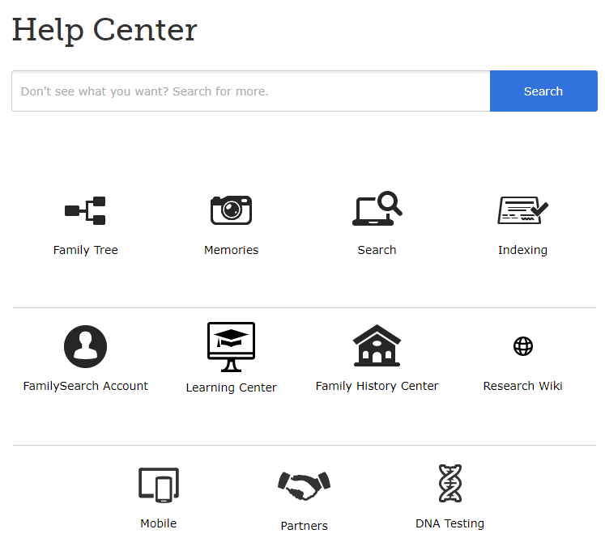
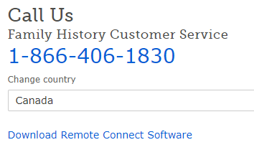

Slide 5
Consider Using Wild Cards When Searching Problem Ancestors
Shift ? for ONE missing letter
e.g. Co?k for Cook
Shift * for up to 3 missing letters in a word
e.g. Co*k* for Cooke
e.g. G*l*nz*wski for Galenzowski
Do not use Wild Cards and Variants in the same search e.g. Findmypast
Enter place
Enter time period

Slide 6
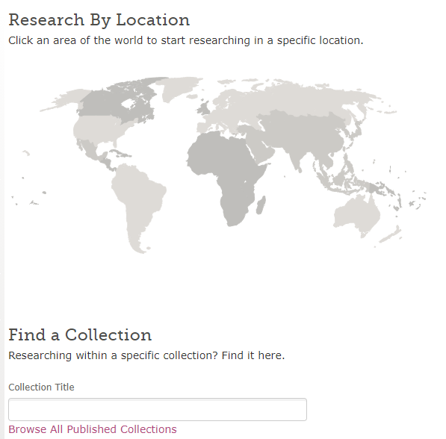
Add a Country to the Collection Title or
Select Browse All Published Collections

Slide 7
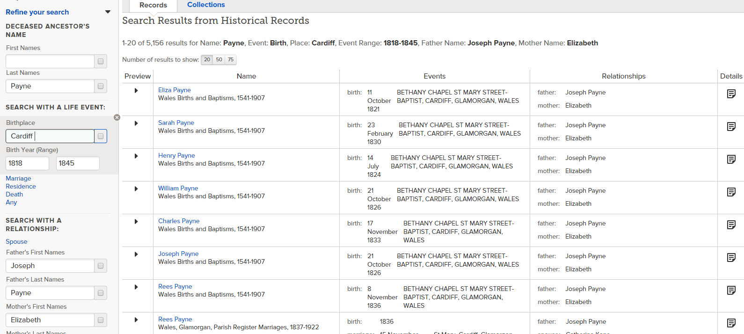
Searching for Siblings, Enter last name, Place, Year range & Parents

Slide 8
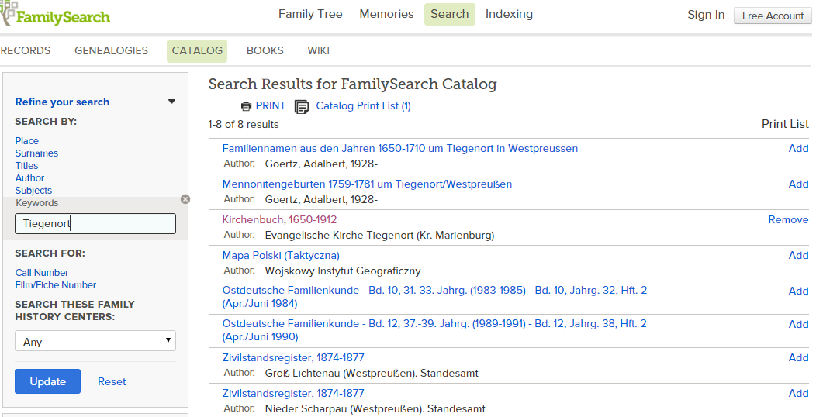
Library Catalogue Search – Catalogue Select - Keywords

Slide 9
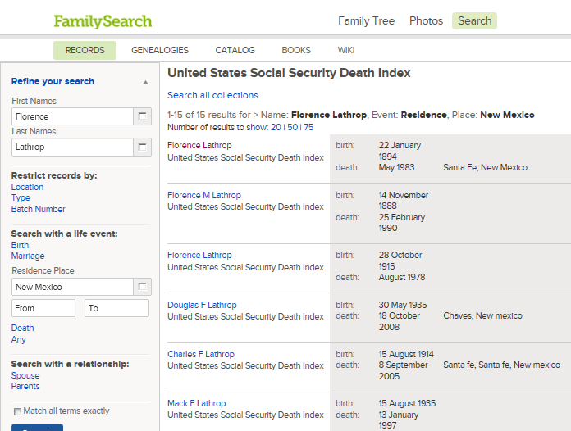
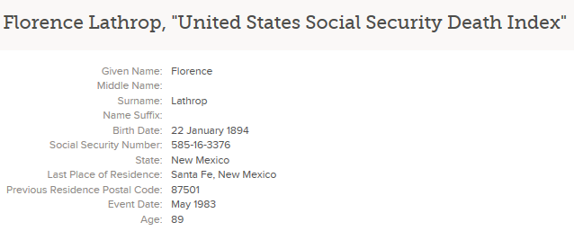
US Social Security Death Index https://familysearch.org/search/collection/1202535
Located on:
Familysearch
To February 2014
Ancestry..........
To March 2014
Findmypast..........
To 2012

Slide 10
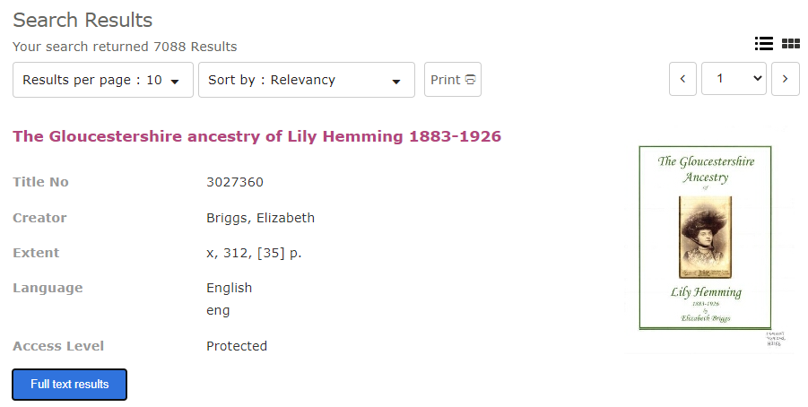
Search - Books

Slide 11
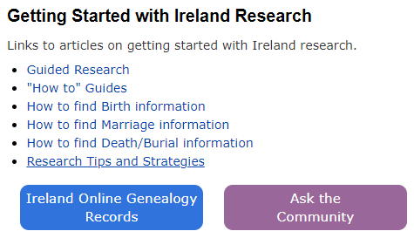
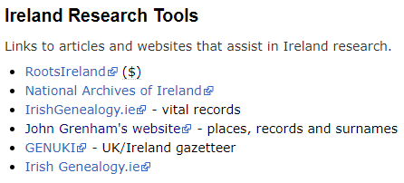
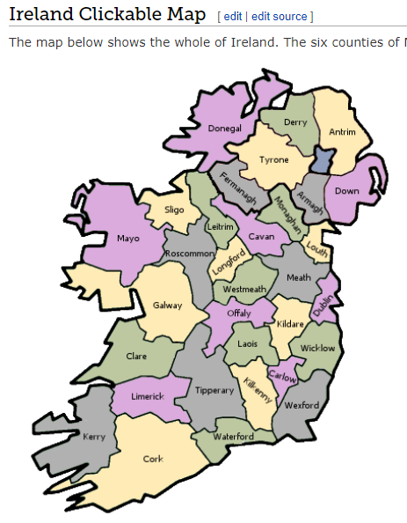
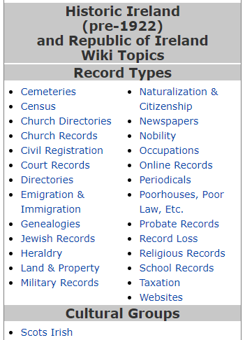
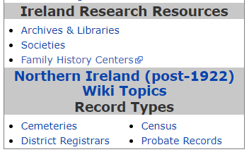
Home – Search –Wiki - Ireland

Slide 12
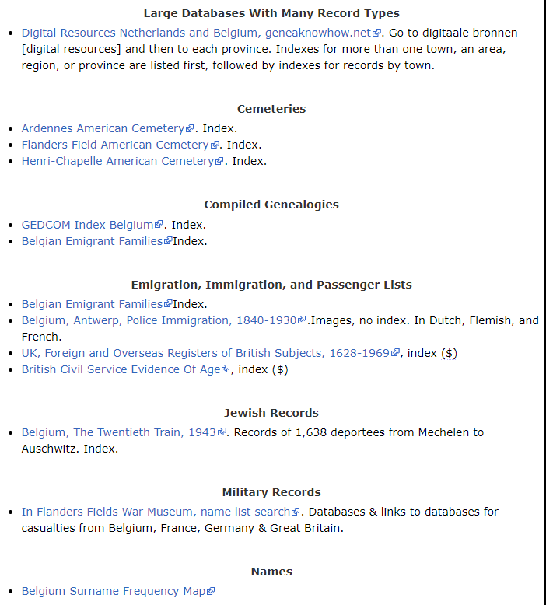
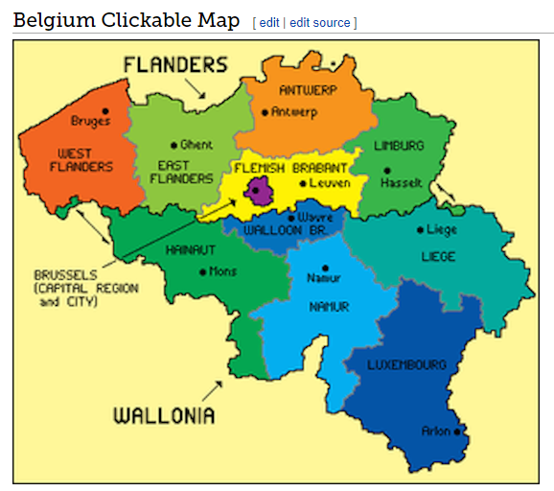
https://familysearch.org/wiki/en/Belgium_Genealogy

Slide 13
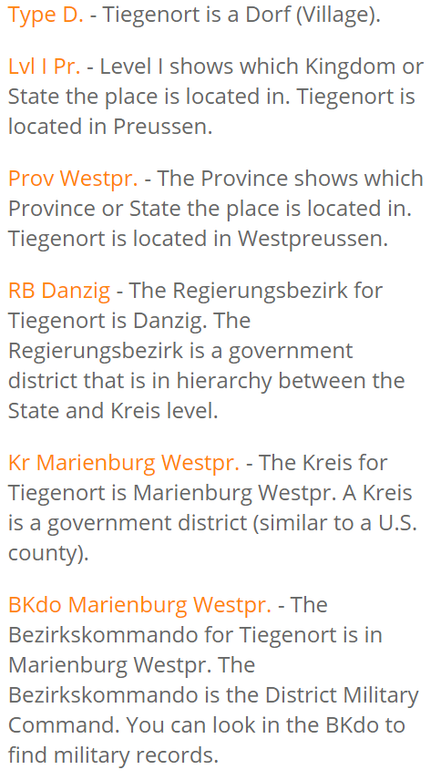
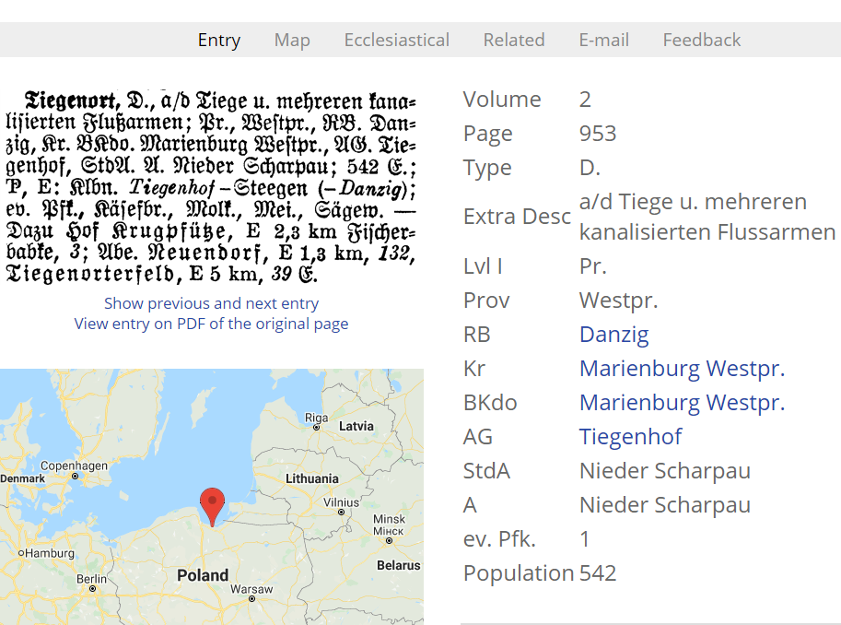
Meyers Gazeteer Meyers Gazetteer - An online, searchable version with historical maps

Slide 14
Library & Archives Canada http://www.bac-lac.gc.ca/eng/Pages/home.aspx

Slide 15
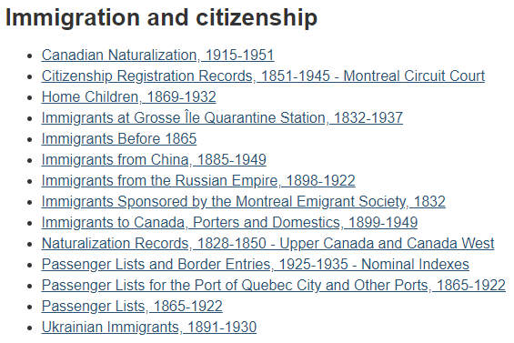
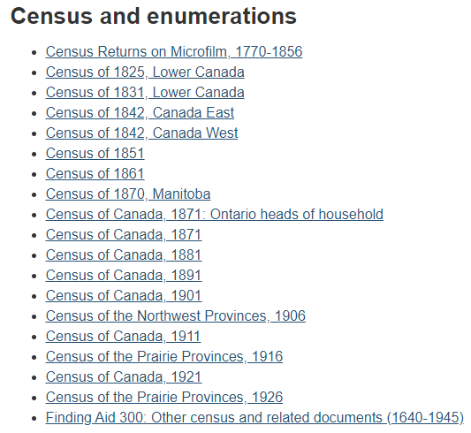
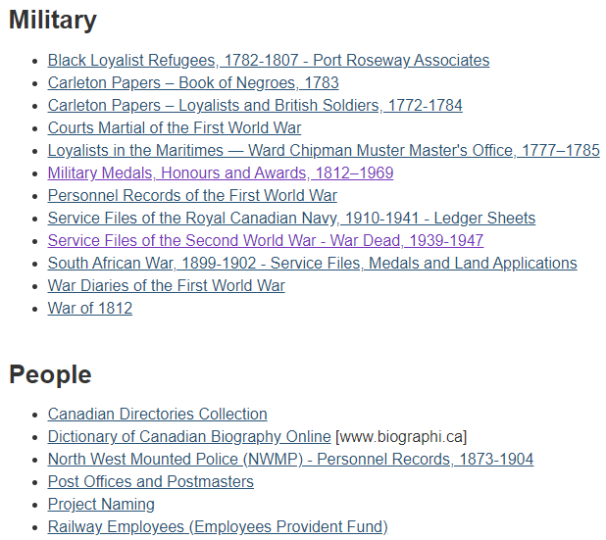
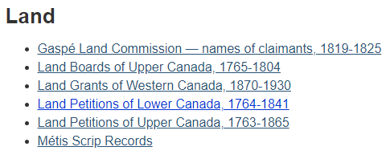
Databases on LAC

Slide 16
Immigration & Citizenship
Residence in Canada from 2-5 years
Records from 1854-1917 destroyed but indexes survive
Present & former place of residence;
former nationality;
occupation;
date of certification;
name and location of court
After 1917
Surname Given Name
Date and place of Birth Entry into Canada
Names of spouses and children
Naturalization Database 1915-1951

Slide 17
Naturalization Records
Citizenship and Immigration Canada
Public Rights Administration
10th Floor, 360 Laurier Avenue West
Ottawa, ON K1A 1L1
Application on an Access to Information Request Form.
Cost $5.00
Signed consent required from living individual or proof of death required, e.g. obituary, death certificate, gravestone photograph
Often found with Homestead Records

Slide 18
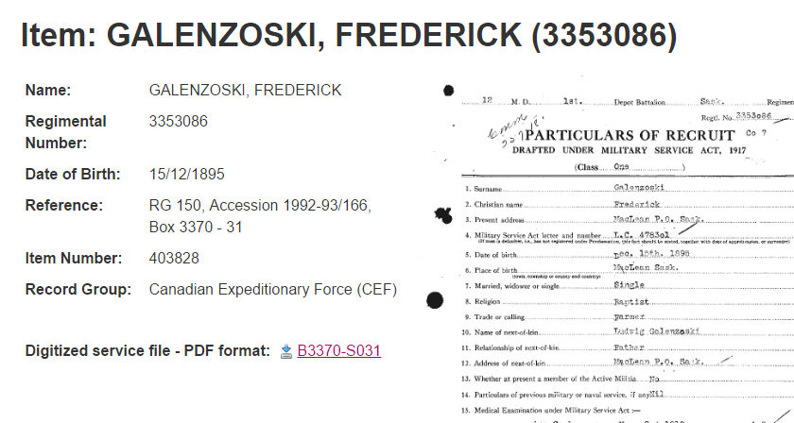
Military Records - World War I

Slide 19
www.bac-lac.gc.ca/eng/discover/aboriginal-heritage/metis/Pages/metis-genealogy.aspx

Slide 20
Métis Scrip Records

Slide 21
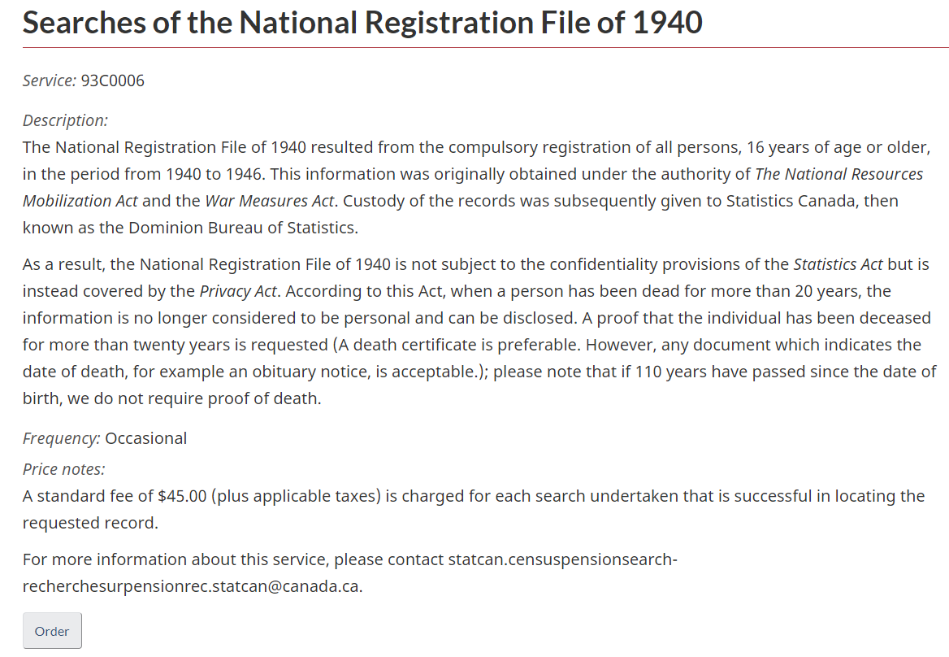
National Registration – 1940 www5.statcan.gc.ca/olc-cel/olc.action?ObjId=93C0006&ObjType=22&lang=en&limit=0

Slide 22
Census Availability
Canada
Taken 1 June 1931
Available 2023 [92 years]
United States
Taken 1 June 1950
Available 2022 [72 years]
Britain
Taken 19 June 1921
Available 2 January 2022 [100 years]
No census for 1931, destroyed by fire
No census for 1941 due to the war, substitute with the National Registry of September 1939

Slide 23
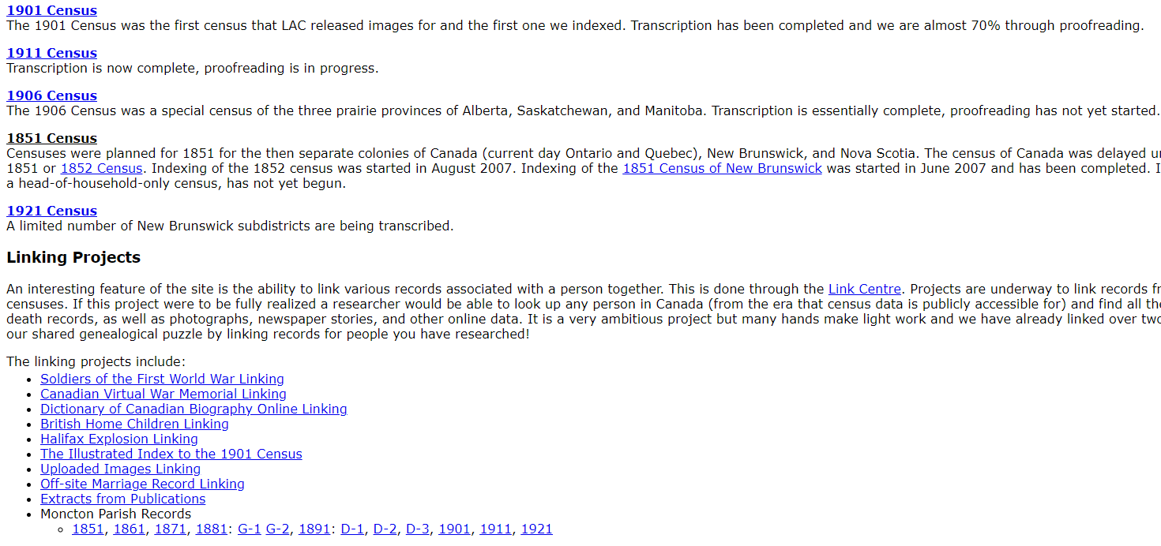
Automated Genealogy - Free http://automatedgenealogy.com/

Slide 24
French and Métis Genealogy
Contact Société historique de Saint-Boniface 340 Provencher Blvd
tele: 233-4888
http://shsb.mb.ca/genealogie
Métis ancestry traces individuals direct ancestors prior to 1870
Try National Archives of Canada
French Canadian Archives
Indexes – Loiselle, Tanguay, Rivest and Drouin
copies of parish registers
newspapers – early 19th century Quebec….
census
correspondence…………

Slide 25
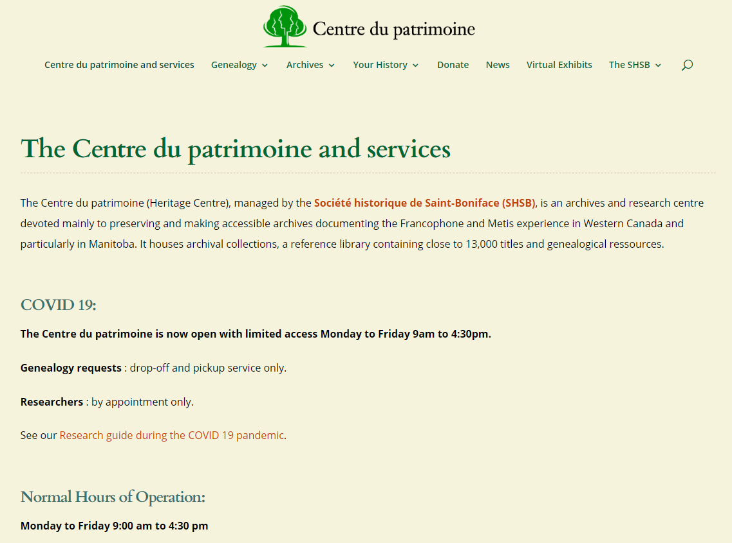
http://shsb.mb.ca/genealogie

Slide 26
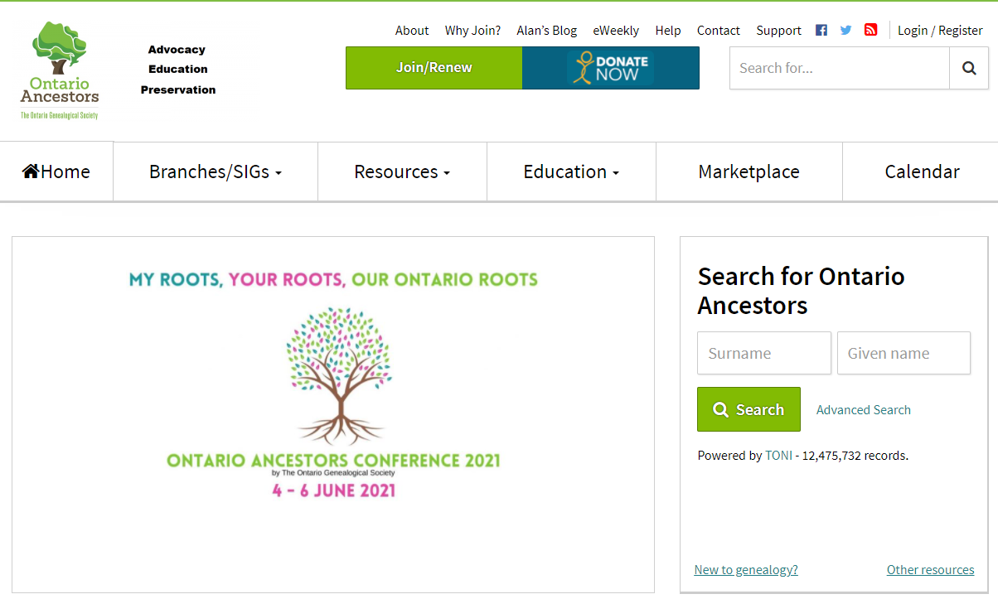
Check out the Local Genealogical Society www.ogs.on.ca/

Slide 27
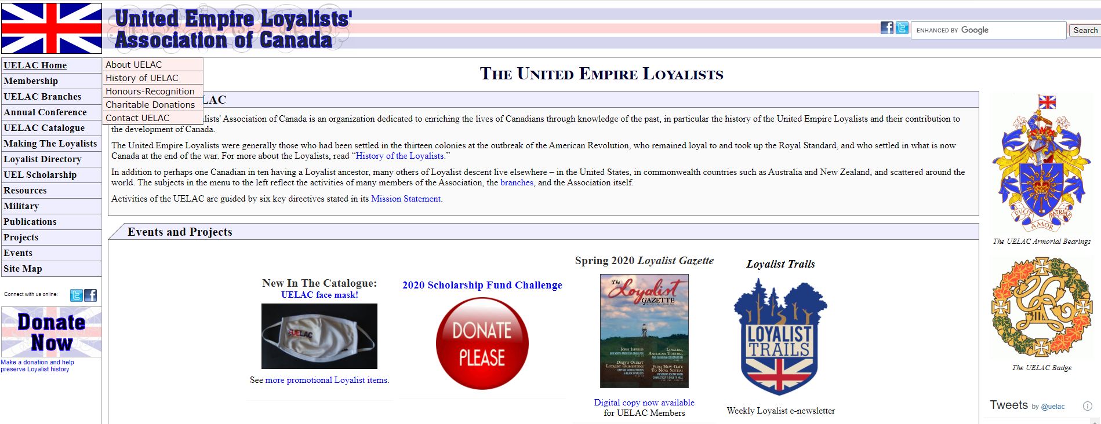
www.uelac.org/

Slide 28
Archives Manitoba
Census records
From 1831-1906
Court Records
Wills
Winnipeg Index on website
Divorce Records
Land Records
Immigration
Ships’ Passenger Lists 1865-1919
School Records –Half Yearly Attendance Records 1915-1980……

Slide 29
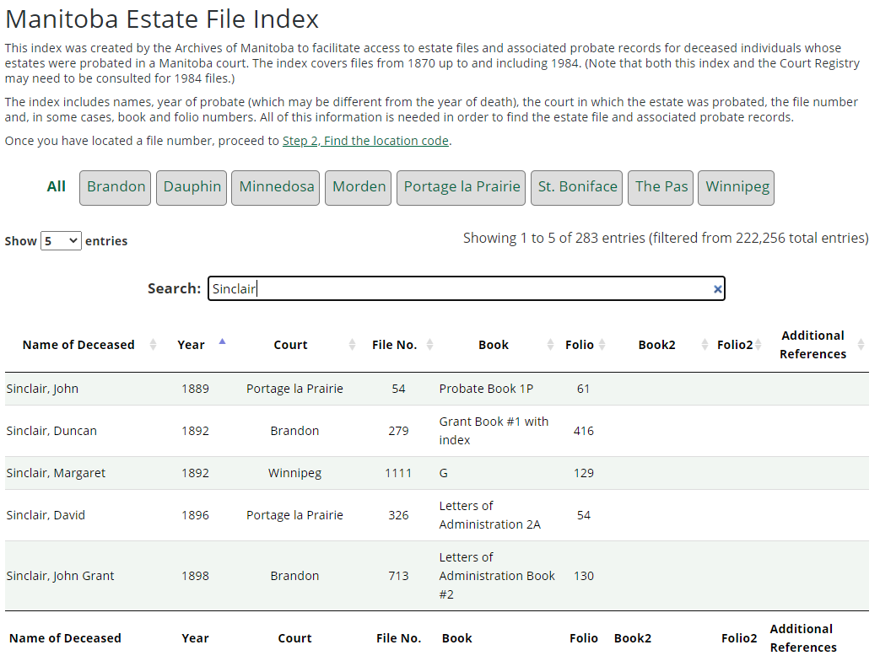
Winnipeg Estate Index – 1870-1984 Manitoba Estate File Index | Manitoba Estate Files | Archives of Manitoba (gov.mb.ca)

Slide 30
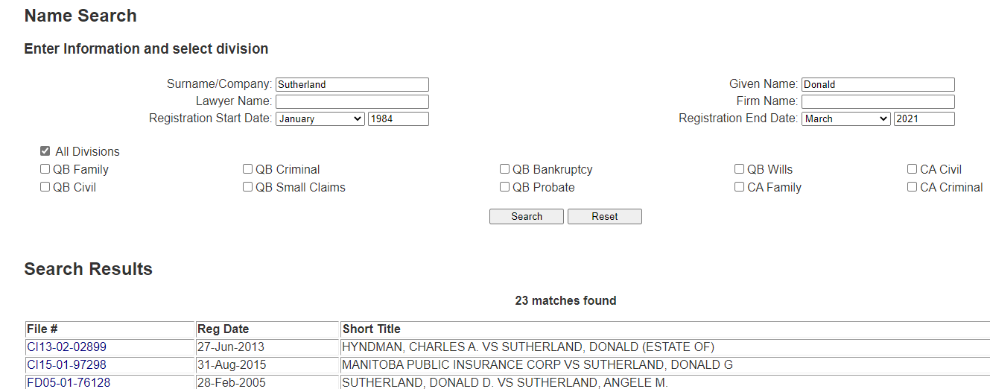
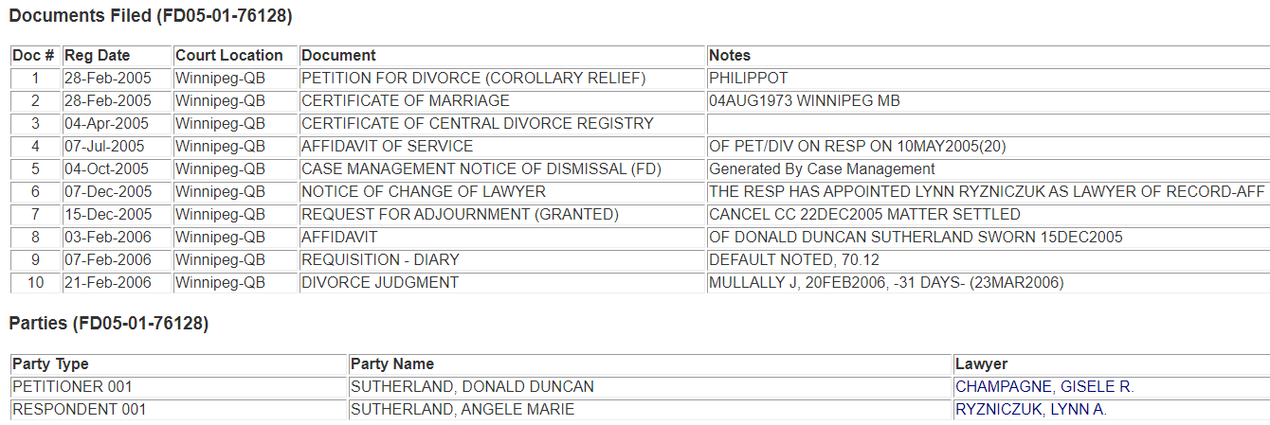
Court Registry System https://web43.gov.mb.ca/Registry/NameSearch

Slide 31
Hudson’s Bay Company Archives www.gov.mb.ca/chc/archives/hbca/index.html
Biogs on-line
Census indexes, 1827
Land Records under Lord Selkirk
Wills
Post Journals some information on-line
Servants’ Contracts
1776-1926, 10,000 on a database at:
HBC Archives
MGS Resource Centre
Employee application forms
Shareholders papers
Copies of Parish Registers
Private Papers
Many more………….

Slide 32
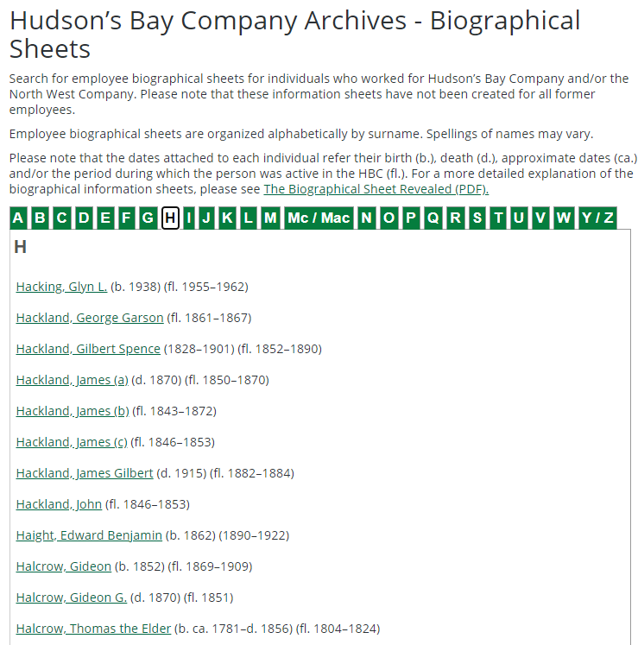
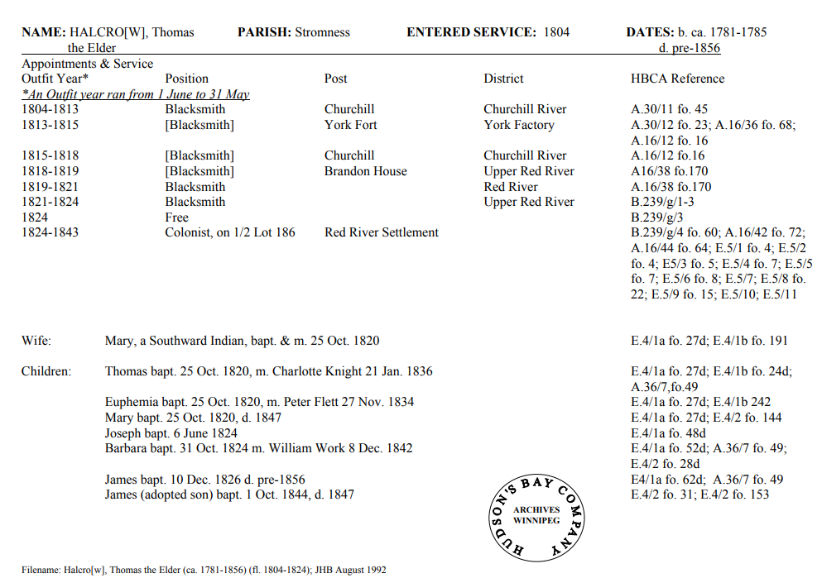
www.gov.mb.ca/chc/archives/hbca/biographical/index.html

Slide 33
www.mbgenealogy.com/

Slide 34
Manitoba Genealogical Society www.mbgenealogy.com/
Cemetery Indexes
Newspaper Indexes
Census Indexes, 1827-1911
Census Indexes on line for USA, Canada some UK
www.ancestry.com
https://familysearch.org/ Free
Church Indexes https://wiki.familysearch.org/en/Manitoba_Church_Records
United Church Records, 515 Portage Ave. Winnipeg Tele: 783.0708
Anglican Church Records, 935 Nesbitt Bay, Winnipeg Tele: 992-4200
Aboriginal Records
Canadian & International Journals
International fiche and CD’s
Seminars & monthly branch meetings
Many more………………….

Slide 35
Henderson’s Directory
Date to early twenty-first century
Up to 1908 included Manitoba and Assiniboine Territories
After 1908 Winnipeg
Some locations include
Legislative Library
Millennium Library
Local Studies Room
Manitoba Genealogical Society Research Centre – St James
Not all sites have a complete set of Directories

Slide 36
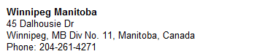
LDS Library
Winter hours:
Mon. 10 am - 4 pm Wed 10 am - 3 pm
Tues. and Thurs. 6:30 pm - 9:30 pm
Databases include:
www.ancestry.com [World wide database]
www.findmypast.co.uk/home[British, Migration]
www.findmypast.ie/ [Ireland]
www.thegenealogist.co.uk/ [British]
www.fold3.com/ [American military]
http://myheritagelibraryedition.com/research [My Heritage]

Slide 37
East European Genealogy
Contact East European Genealogical Society (Winnipeg) – tele: 989-3292;
Email www.eegsociety.org/Home.aspx
Try the www for the:
name;
census;
area in North America where they lived;
country of origin;
Contact the Genealogical Society for the area where your ancestors lived.

Slide 38
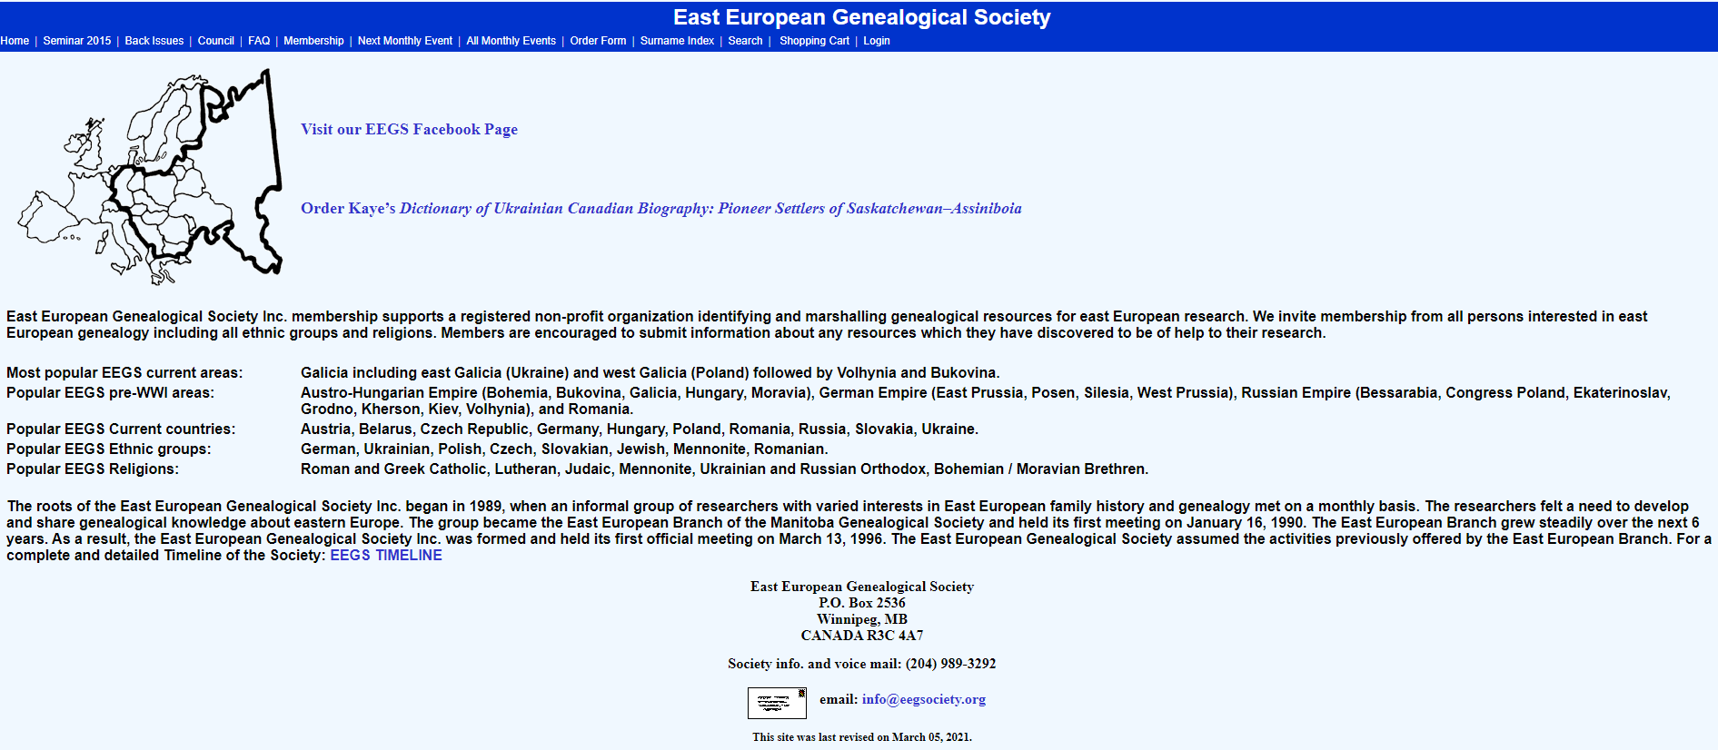
East European Genealogical Society www.eegsociety.org/Home.aspx

Slide 39
Manitoba Research done by Shirley Kulchyski
Department of Families holds Old Age Security records for Manitoba. Anyone wishing to request these records should fill out an application www.gov.mb.ca/fippa/pdfs/fippa_appform.pdf and send it to my attention either by mail, or via fax at:
Sharon Field
Access and Privacy Coordinator
Department of Families
Winnipeg MB R3C 4V4
Fax: 204-945-2156
Tele: 204-945-2013
Also try Library and Archives Canada
www.bac-lac.gc.ca/eng/Pages/home.aspx
Tele: 1-613-996-5115 or 1-866-578-7777
Fax: 1-613-995-6274

Slide 40
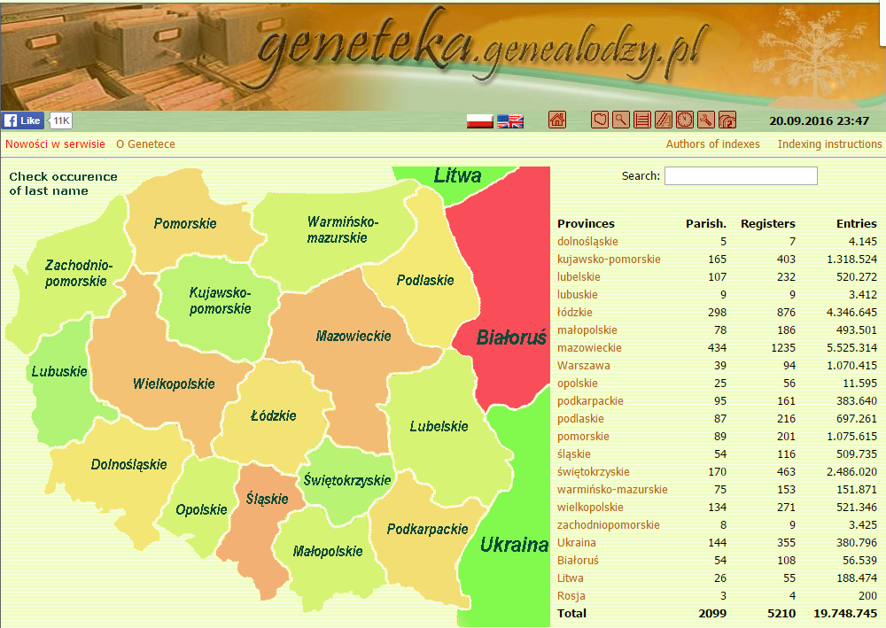
www.geneteka.genealodzy.pl/index.php?lang=eng

Slide 41
Winnipeg Public Library
On line catalogue
Instructional Programs with Speakers
www.ancestry.com
All Winnipeg Libraries
Reference sources “How to…..”
Current Educational Programs
Historical & Geographical materials
References on Surnames
References on Illness
Link to Internet
Instructional Seminars
Many more……….

Slide 42
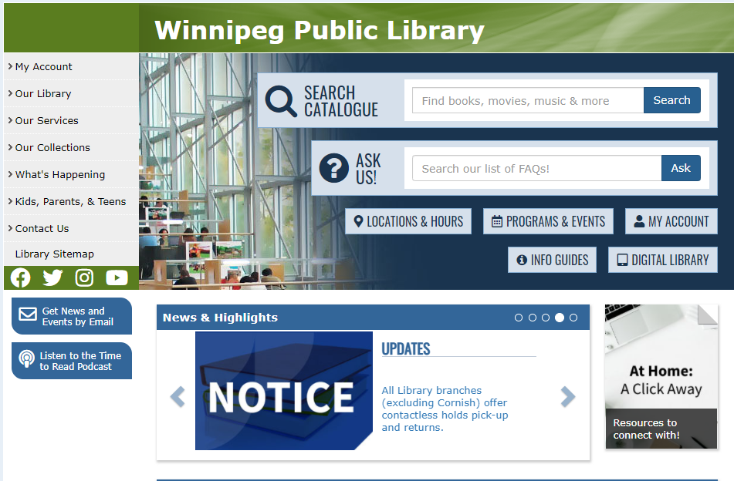
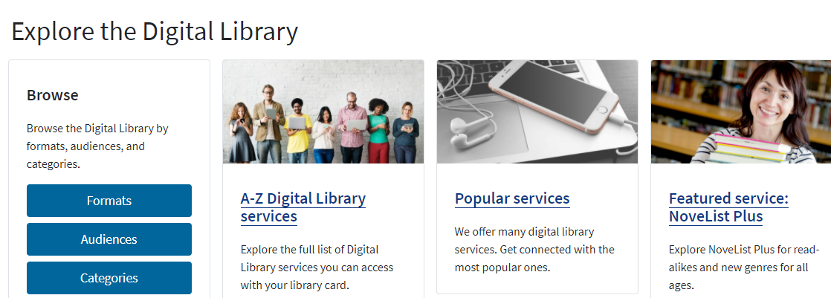
http://wpl.winnipeg.ca/library/

Slide 43
www.ancestry.com
Available at:
All Winnipeg Libraries
Manitoba Genealogical Society
Centre du Patrimoine-Provencher
LDS Library, Dalhousie Drive
Free: once in a lifetime14 day trial

Slide 44
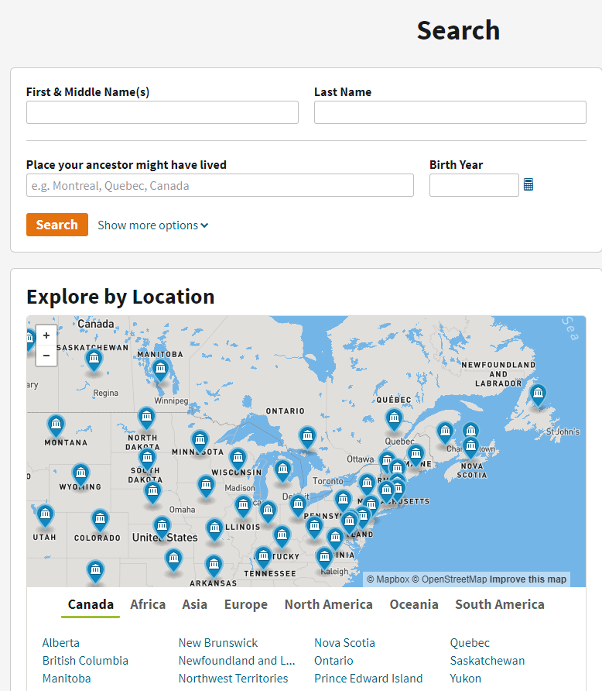
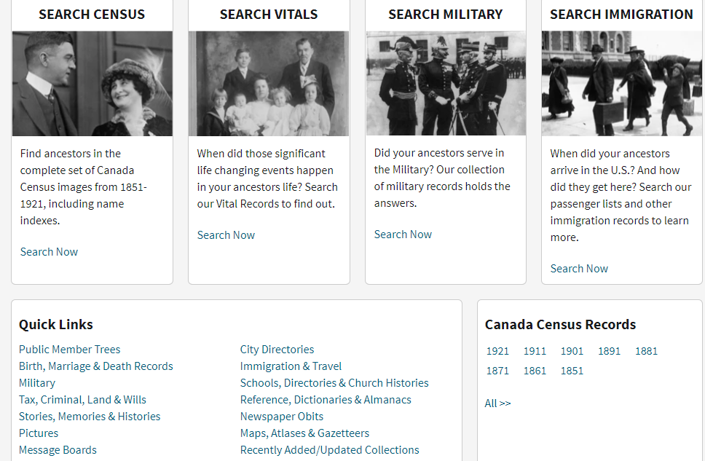
www.ancestry.ca/ Select Search

Slide 45
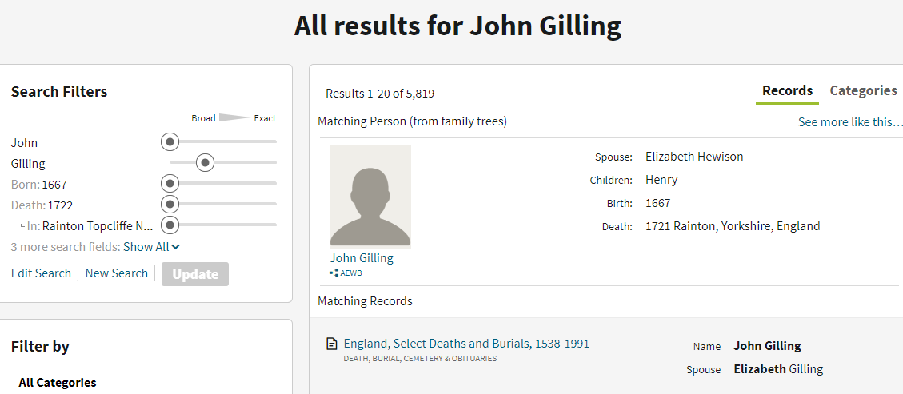
Ancestry – Public Member Trees

Slide 46
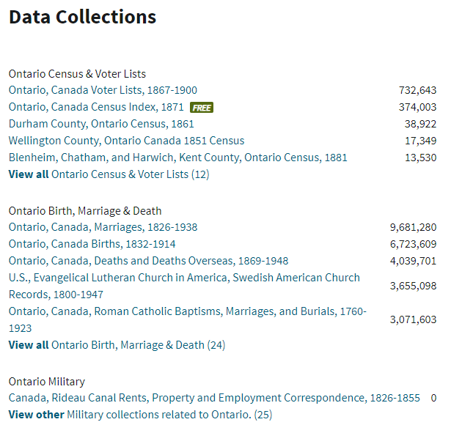
Select Ontario, Enter See More About Ontario, Enter

Slide 47
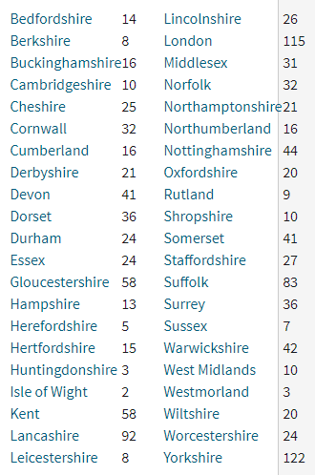
Go to Search, Select Europe, England, Gloucestershire

Slide 48
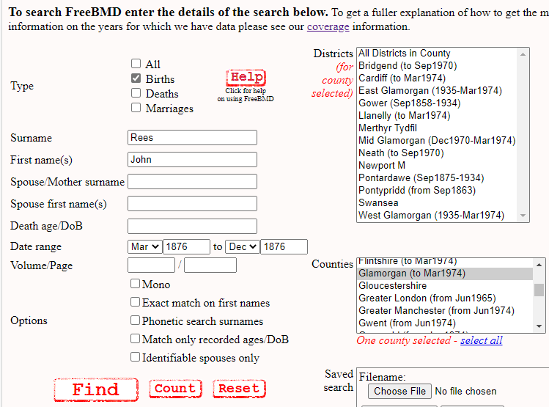
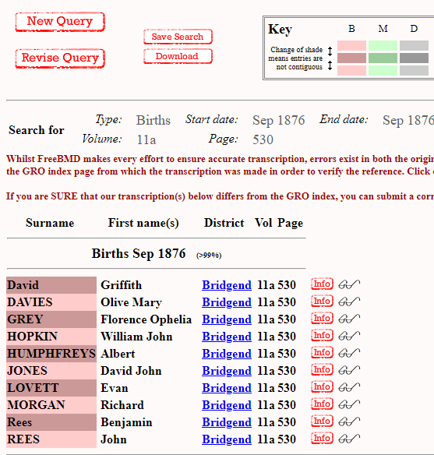
Birth Marriage Death BMDs – Free Index England & Wales from 1837 www.freebmd.org.uk/

Slide 49
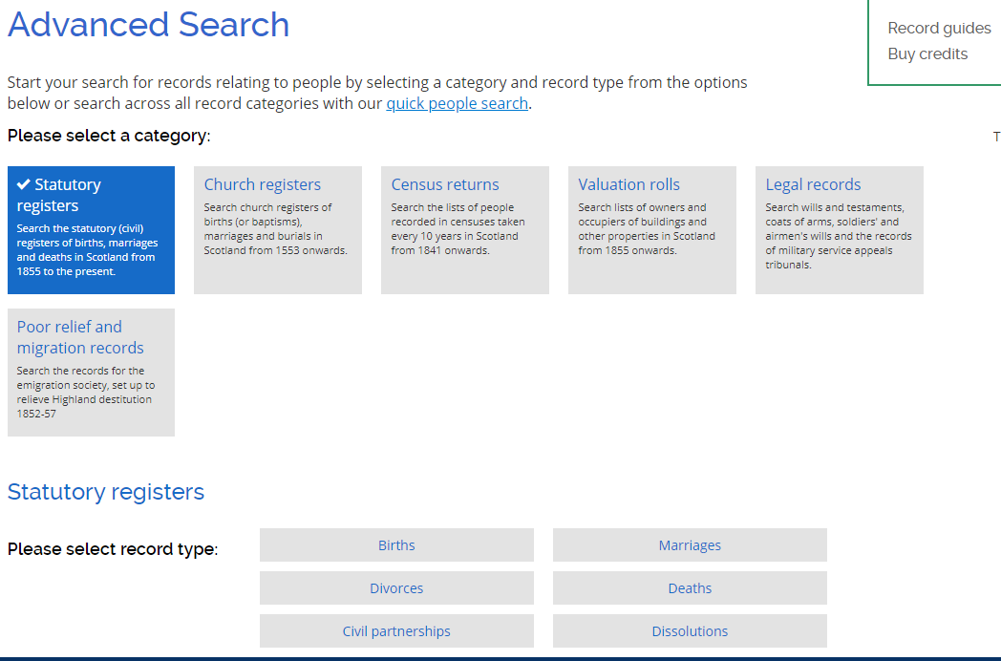
Scotland: Birth Marriage Death Census Wills from 1553 – Pay per view www.scotlandspeople.gov.uk/

Slide 50
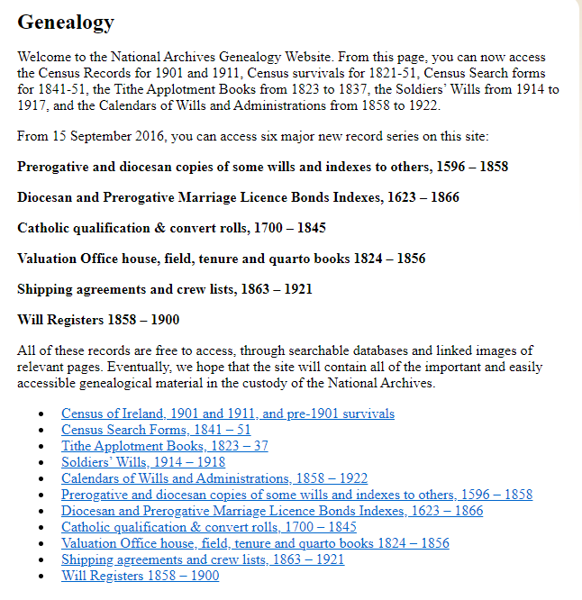
National Archives Dublin Genealogy (nationalarchives.ie)

Slide 51
Public Record Office Northern Ireland Family and local history records | nidirect

Slide 52
www.findmypast.co.uk/

Slide 53
Newspapers

Slide 54
Free Reg BMDs from Church Records www.freereg.org.uk

Slide 55
www.dustydocs.com

Slide 56
www.genuki.org.uk/

Slide 57
Maps
Location of cities, towns, addresses
Major roads between towns and villages
Location of farms, manors or property
Estate maps indicates local tenants
Tithe maps show the amount owed to the parish incumbent
Political boundaries, parish boundaries

Slide 58
West Prussia 1882 | FEEFHS

Slide 59
http://maps.google.ca/

Slide 60
Old Maps www.old-maps.co.uk/#/

Slide 61
Parish Maps www.genuki.org.uk/sites/default/files/media/colin_hinson/YKS/YRY/Maps/NRYparishes.png

Slide 62
Estate Map
BRO DEC E 13

Slide 63
What happened if you were sick?
No antibiotics - infectious diseases were the killers
Mothers died of childbed fever
No ASA, no Tylenol
Herbal remedies and metallic salts were common
Children were given Opium to make them sleep

Slide 64
Approaches to Therapy
Physical/Clinical
Blood Letting & Cupping
Restraint
Amputation
Chemical
Remove & Eliminate Cause
Symptomatic Treatment

Slide 65
Laudanum
Tincture of opium [solution of opium in alcohol]
Major pain reducing drug of the nineteenth century
Used to treat cough and diarrhoea

Slide 66
Opium Poppy – Papaver somniferum

Slide 67
Digoxin
Reported use of foxglove to treat dropsy (1785)
Digoxin & other heart medications isolated in 19th century
Digoxin used today as a heart strengthening drug

Slide 68
Foxglove - Digitalis purpurea
Contains active ingredient Digoxin
Strengthens heart beat

Slide 69
Puerperal Fever
Infection during childbirth
Mother could die a few days after delivery
Mother:
more likely to die at a lying in hospital
Less likely to die with a midwife in a rural setting
Family left without mother, father often remarried quickly
Problem partly solved in late 19th century

Slide 70
Old Terminology - Diseases
Quinsy, Tonsilitis, Strep Throat
Phthisis, Consumption, Tuberculosis
Ague – Fever particularly malaria
Clap – Gonorrhea
Devonshire Colic – Lead poisoning
Flux – associated with Dysentery
Screws – Rheumatism
Stone Pox - Acne

Slide 71
Old Terminology - Medications
Epsom Salts [Magnesium sulfate] acts as a purgative or cathatic used for constipation, rheumatism, arthritis & lumbago
Hutchinson’s Pill [chalk, opium & mercury] used to treat syphilis (toxic)
Aqua vitae [water of life] brandy
Dover’s Powders Sedative, Narcotic, Diaphoretic

Slide 72
Further Information Available at MGS

